Slide 1
NeurIPS 2018
Differentiable MPC for End-to-End Planning and Control
Brandon Amos¹
Ivan Dario Jimenez Rodriguez²
Jacob Sacks²
Byron Boots²
J. Zico Kolter¹³
¹Carnegie Mellon University
²Georgia Tech
³Bosch Center for AI

Slide 2
Should RL policies have a system dynamics model or not?
Policy
Neural Network(s)
State
Action
System Dynamics
Future Plan
Model-free RL
More general, doesn’t make as many assumptions about the world
Rife with poor data efficiency and learning stability issues
Model-based RL (or control)
A useful prior on the world if it lies within your set of assumptions

Slide 3
Combining model-based and model-free RL
Recently there has been a lot of interest in model-based priors for model-free reinforcement learning:
Among others: Dyna-Q (Sutton, 1990), GPS (Levine and Koltun, 2013), Imagination-Augmented Agents (Weber et al., 2017), Value Iteration Networks (Tamar et al., 2016), TreeQN (Farquhar et al., 2017)
These typically involve:
Using an RNN: Efficient but not as expressive and general as MPC/iLQR
Unrolling an LQR or gradient-based solver: Expressive/general but inefficient
Our approach: Differentiable Model-Predictive Control
Explicitly solves a control problem

Slide 4
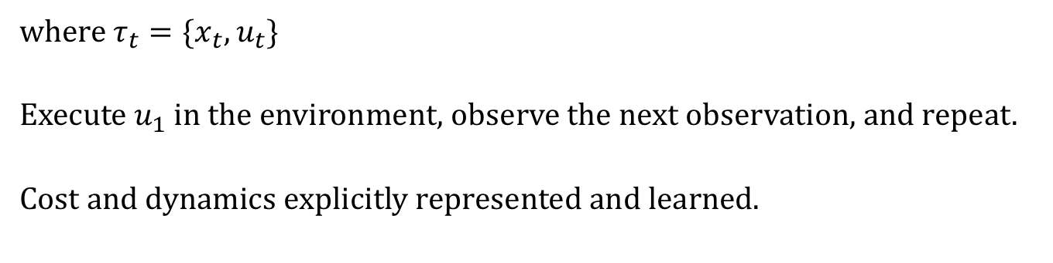
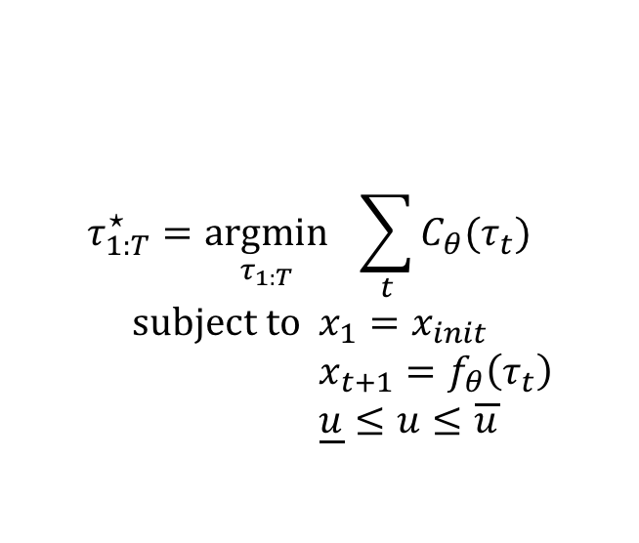
Our Approach: Model Predictive Control
Traditionally viewed as a pure planning problem given known (potentially non-convex) cost and dynamics:
$$τ_{1:T}^{⋆}=\underset{τ_{1:T}}{argmin}{ \sum_{t}{C_{θ}(τ_{t})}} \\ \text{subject} \text{to} x_{1}=x_{init} \\ x_{t+1}=f_{θ}\left(τ_{t}\right) \\ \underline{u}≤u≤\overline{u}$$
Cost
Dynamics
where $τ_{t}=\{x_{t}, u_{t}\}$
Execute $u_{1}$ in the environment, observe the next observation, and repeat.
Cost and dynamics explicitly represented and learned.

Slide 5
Model Predictive Control with SQP
The standard way of solving MPC is to use sequential quadratic programming (SQP), using LQR in most cases
Form approximations to the cost and dynamics around the current iterate
Repeat until a fixed point is reached and differentiate through it

Slide 6
LQR, KKT Systems, and Differentiation
Solving LQR with dynamic Riccati recursion efficiently solves the KKT system
Backwards Pass: Use the OptNet approach from [Amos and Kolter, 2017] to implicitly differentiate the LQR KKT conditions:
where
Just another LQR problem!

Slide 7
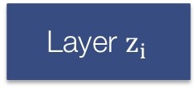
A Differentiable MPC Module
We can differentiate through (non-convex) MPC with a single (convex) LQR solve by differentiating the SQP fixed point
A lot of data
Model
Predictions
Loss
…
Layer $z_{i}$
MPC Layer
…
What can we do with this now?
Replace neural network policies in model-free algorithms with MPC policies, and also replace the unrolled controllers in other settings (hindsight plan, universal planning networks)
The cost can also be learned! No longer have to hard-code in a known value.

Slide 8
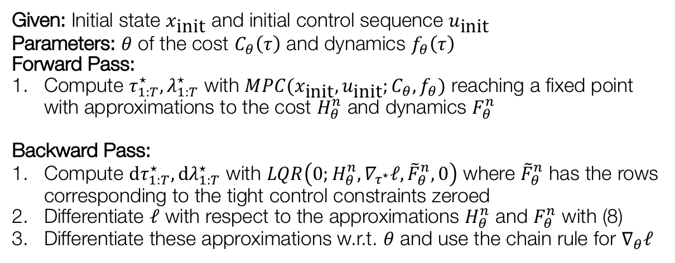
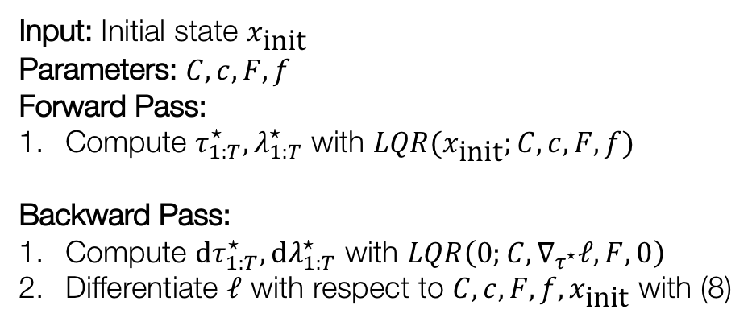
Learnable LQR Module
Input: Initial state $x_{\text{init}}$
Parameters: $C, c, F, f$
Forward Pass:
Compute $τ_{1:T}^{⋆}, λ_{1:T}^{⋆}$ with $LQR(x_{\text{init}};C, c, F, f)$
Backward Pass:
Compute ${\text{d}τ}_{1:T}^{⋆}, {\text{d}λ}_{1:T}^{⋆}$ with $LQR\left(0;C, ∇_{τ^{⋆}}ℓ, F, 0\right)$
Differentiate $ℓ$ with respect to $C,c,F,f,x_{\text{init}}$ with (8)
Learnable MPC Module
Given: Initial state $x_{\text{init}}$ and initial control sequence $u_{\text{init}}$
Parameters: $θ$ of the cost $C_{θ}\left(τ\right)$ and dynamics $f_{θ}\left(τ\right)$
Forward Pass:
Compute $τ_{1:T}^{⋆}, λ_{1:T}^{⋆}$ with $MPC(x_{\text{init}}, u_{\text{init}};C_{θ}, f_{θ})$ reaching a fixed point with approximations to the cost $H_{θ}^{n}$ and dynamics $F_{θ}^{n}$
Backward Pass:
Compute ${\text{d}τ}_{1:T}^{⋆}, {\text{d}λ}_{1:T}^{⋆}$ with $LQR\left(0;H_{θ}^{n}, ∇_{τ^{⋆}}ℓ, {\tilde{F}}_{θ}^{n}, 0\right)$ where ${\tilde{F}}_{θ}^{n}$ has the rows corresponding to the tight control constraints zeroed
Differentiate $ℓ$ with respect to the approximations $H_{θ}^{n}$ and $F_{θ}^{n}$ with (8)
Differentiate these approximations w.r.t. $θ$ and use the chain rule for $∇_{θ}ℓ$

Slide 9

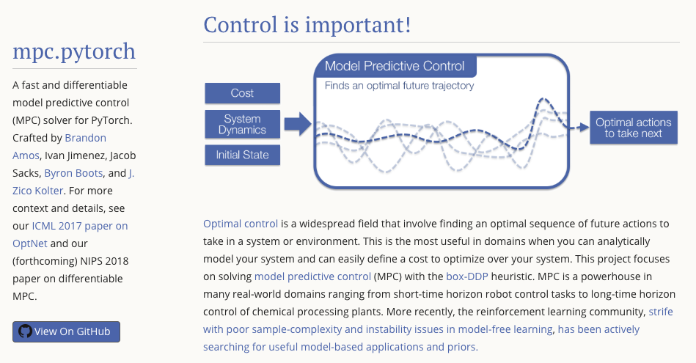
A PyTorch MPC Solver
https://locuslab.github.io/mpc.pytorch

Slide 10
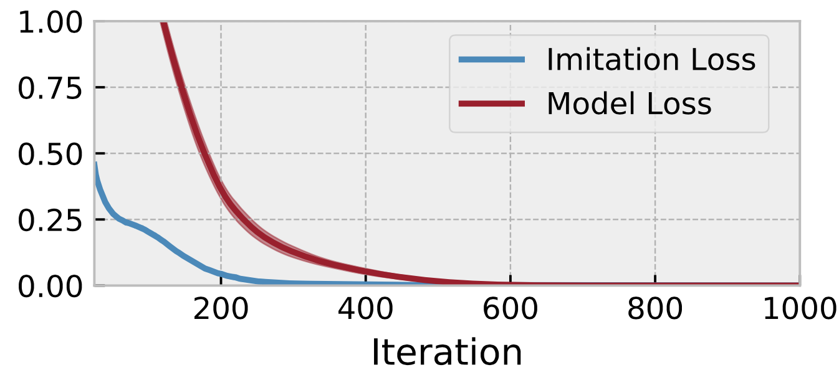

Imitation learning with a linear model
Linear dynamics: $f\left(x_{t}, u_{t}\right)=Ax_{t}+Bu_{t}$
Parameters: $θ=\{A, B\}$
Trajectory: $τ_{θ}\left(x_{\text{init}}\right)$ obtained by MPC
Given known $θ$ and sample trajectories, learn $\hat{θ}$
Trajectory (Training) Loss: $\text{MSE}(τ_{θ}\left(x_{\text{init}}\right), τ_{\hat{θ}}\left(x_{\text{init}}\right))$
Model Loss: $\text{MSE}(θ, \hat{θ})$
Not guaranteed to converge, but a good sanity check that it does in small cases.

Slide 11
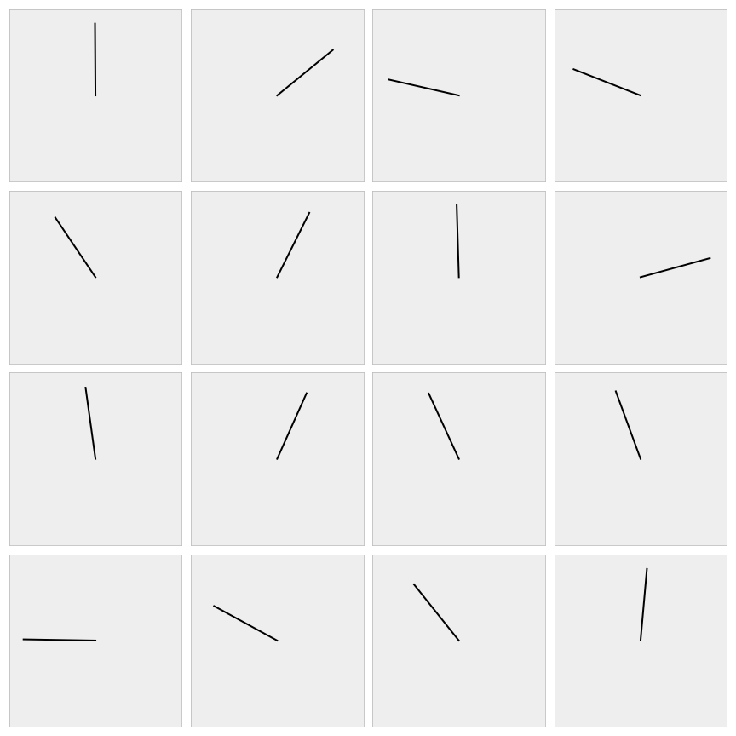
Simple Pendulum Control

Slide 12
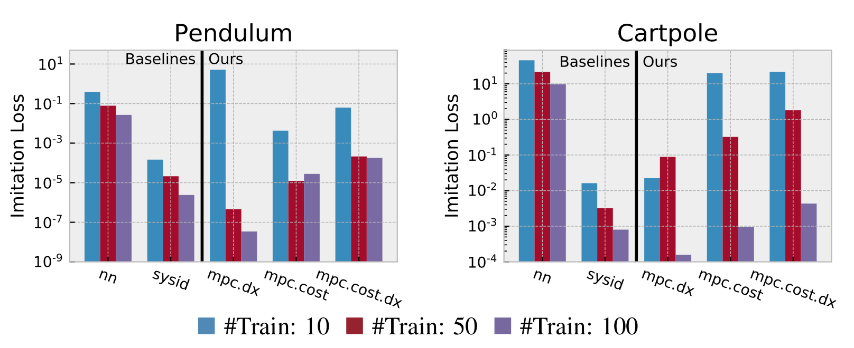
Imitation learning with the pendulum/cartpole
Again optimizes the imitation loss with respect to the controller’s parameters
Using only action trajectories we can recover the true parameters

Slide 13
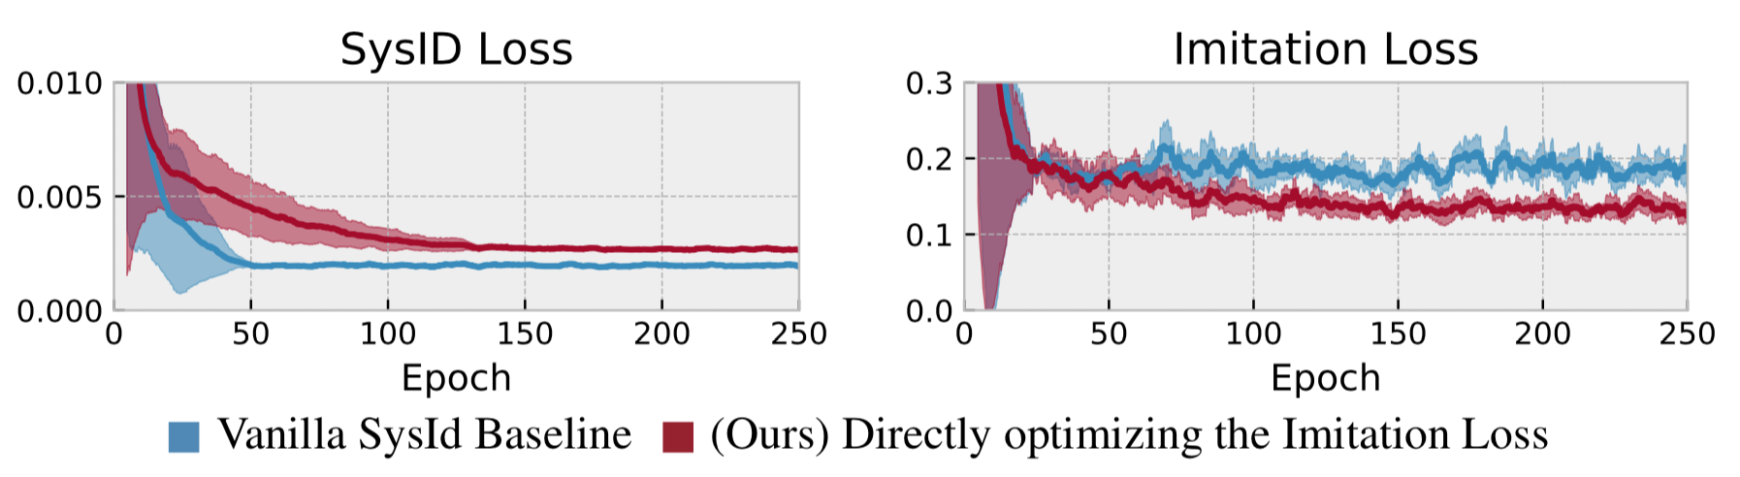
Optimizing the task loss is often better than SysID in the unrealizable case
True System: Pendulum environment with noise (damping and a wind force)
Approximate Model: Pendulum without the noise terms
Best Imitation Loss
Approximate Model Class
True Model
Best MSE

Slide 14
NeurIPS 2018
Differentiable MPC for End-to-End Planning and Control
B. Amos, I. Rodriguez, J. Sacks, B. Boots, J. Z. Kolter
Explicit controllers can be learned just as any other layer and integrated with larger black-pox policy classes
Directly optimizing the task loss of controllers is important to do in addition to standard system identification once a task is known
https://locuslab.github.io/mpc.pytorch
https://github.com/locuslab/differentiable-mpc

