Slide 1
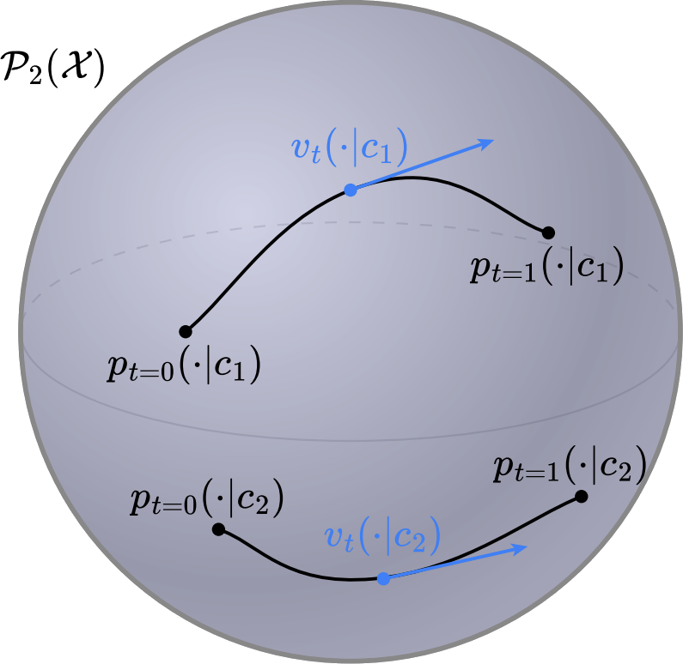

Transport and flows between distributions over distributions
Brandon Amos • Meta, NYC
slides
bamos.github.io/presentations

Slide 2
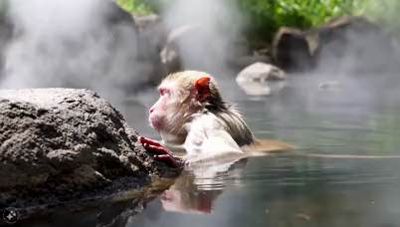
Generative models and media generation
📚 Movie Gen: A Cast of Media Foundation Models. Meta, Oct 2024.
Prompt: A red-faced monkey with white fur is bathing in a natural hot spring. The monkey is playing in the water with a miniature sail ship in front of it, made of wood with a white sail and a small rudder. The hot spring is surrounded by lush greenery, with rocks and trees.

Slide 3
Flows: how we got here
(many extensions/applications)
(a non-exhaustive list)

Slide 4
Flows: how we got here
(many extensions/applications)
(a non-exhaustive list)
(data)
(base)

Slide 5
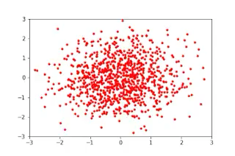
Flows: how we got here
(many extensions/applications)
(a non-exhaustive list)
(data)
(base)
Source: Normalizing Flows in 100 Lines of JAX
parameterize with an invertible function
learn with likelihood

Slide 6
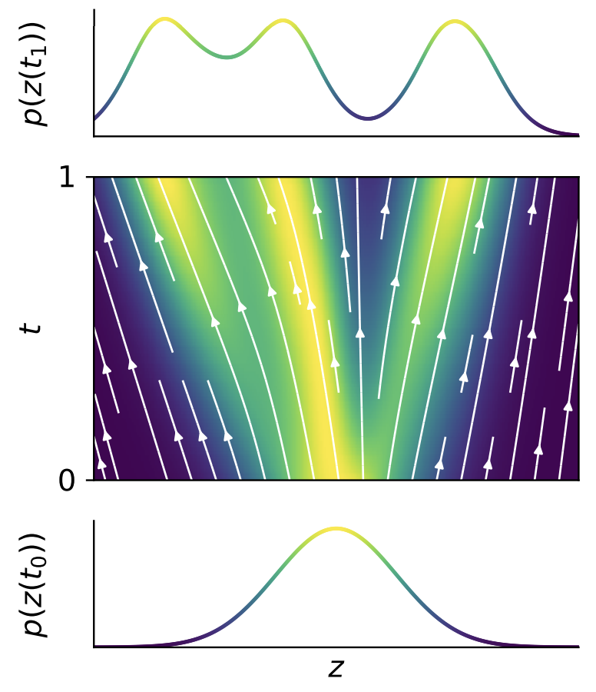

Flows: how we got here
(many extensions/applications)
(a non-exhaustive list)
(data)
(base)
parameterize with an ODE
learn with likelihood
$$\dot{z_{t}}=g\left(z_{t}\right) z_{0}∼p_{X}$$

Slide 7
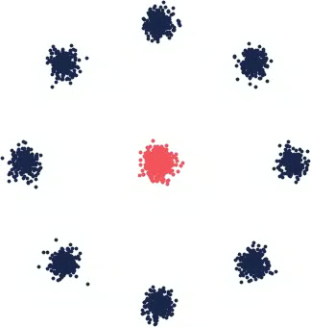


Flows: how we got here
(many extensions/applications)
(a non-exhaustive list)
DDPM
reference path SDE known
score decomposes nicely, learn via a decomposition
$$dX\left(t\right)=∇\log{p\left(X\left(t\right)\right)dt+{\text{2}}^{1/2}dB_{t}}$$
$$X_{t+1}=X_{t}+{ε∇}_{x}\log{p\left(X_{t}\right)+𝒩(0, 2ε)}$$

Slide 8
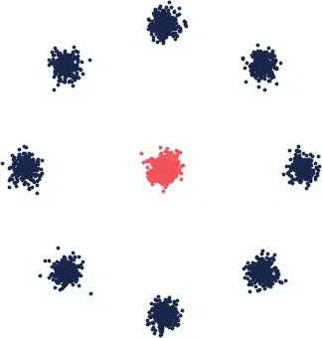


Flows: how we got here
(many extensions/applications)
(a non-exhaustive list)
(data)
(base)
back to an ODE/flow with the same marginals!!
(probability flow ODE, implicit models)
DDPM
DDIM
$$dX\left(t\right)=∇\log{p\left(X\left(t\right)\right)dt+{\text{2}}^{1/2}dB_{t}}$$
$$\dot{z_{t}}=g\left(z_{t}\right) z_{0}∼p_{X}$$

Slide 9

Flows: how we got here
(many extensions/applications)
(a non-exhaustive list)
Match the ODE directly, generalize diffusion path
Still use a ground-truth reference path (or interpolant)
Parameterize flow with an unconstrained neural network
(invertibility comes because the reference transport is invertible!!)
(data)
(base)
$$\dot{z_{t}}=g\left(z_{t}\right) z_{0}∼p_{X}$$

Slide 10
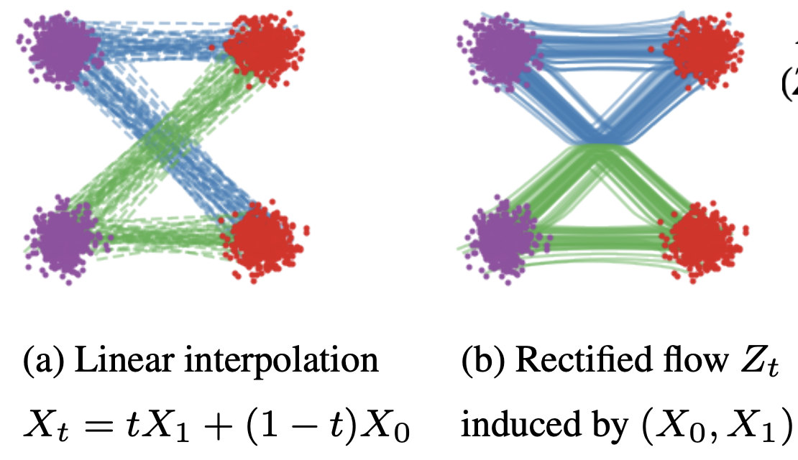

Flows: how we got here
(many extensions/applications)
(a non-exhaustive list)
Match the ODE directly, generalize diffusion path
Still use a ground-truth reference path (or interpolant)
Parameterize flow with an unconstrained neural network
(invertibility comes because the reference path is invertible!)

Slide 11
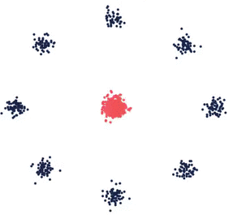
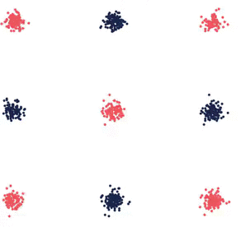
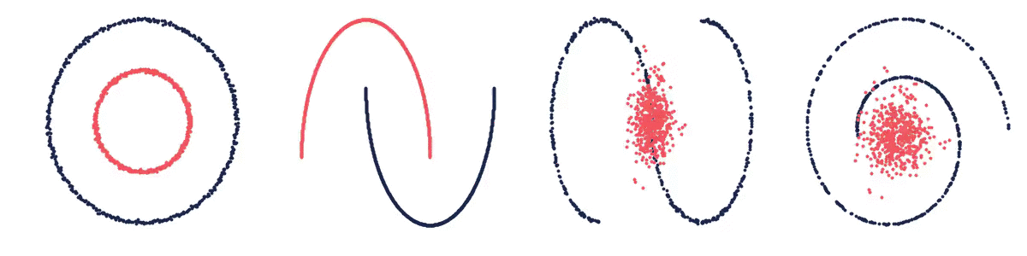
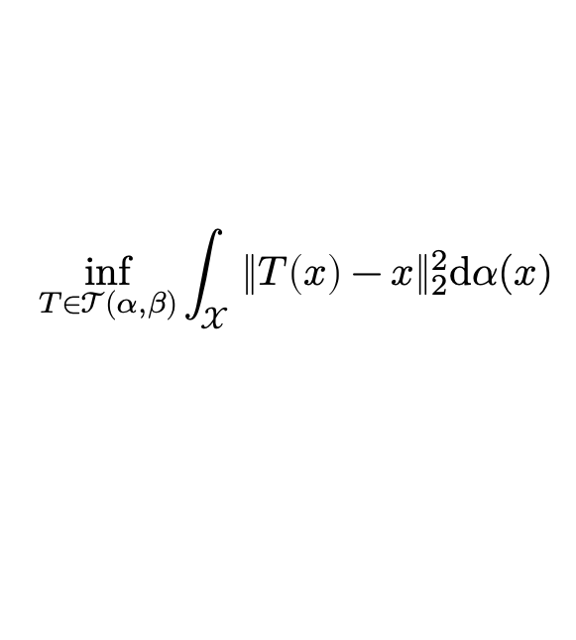
What is optimal transport?
another way of connecting probability measures
📚 Optimal transport: old and new. Villani, 2009.
📚 Optimal Transport in Learning, Control, and Dynamical Systems. Bunne and Cuturi, ICML 2023 Tutorial.
📚 Computational Optimal Transport. Peyré and Cuturi, Foundations and Trends in Machine Learning, 2019.
📚 Optimal Transport for Applied Mathematicians. Santambrogio, Birkhäuser, 2015
📚 Optimal Transport in Systems and Control. Chen, Georgiou, and Pavon, Annual Review of Control, Robotics, and Autonomous Systems, 2021.
📚 Optimal mass transport: Signal processing and machine-learning applications. Kolouri et al., 2017.
Monge’s problem (squared Euclidean)
$$\inf_{T∈𝒯(α, β)}{\int_{𝒳}{{\left\|T\left(x\right)−x\right\|}_{2}^{2}\text{d}α(x)}}$$
find a map connecting $α$ and $β$ that minimally displaces mass
📚 On amortizing convex conjugates for optimal transport. Amos, ICLR 2023.

Slide 12
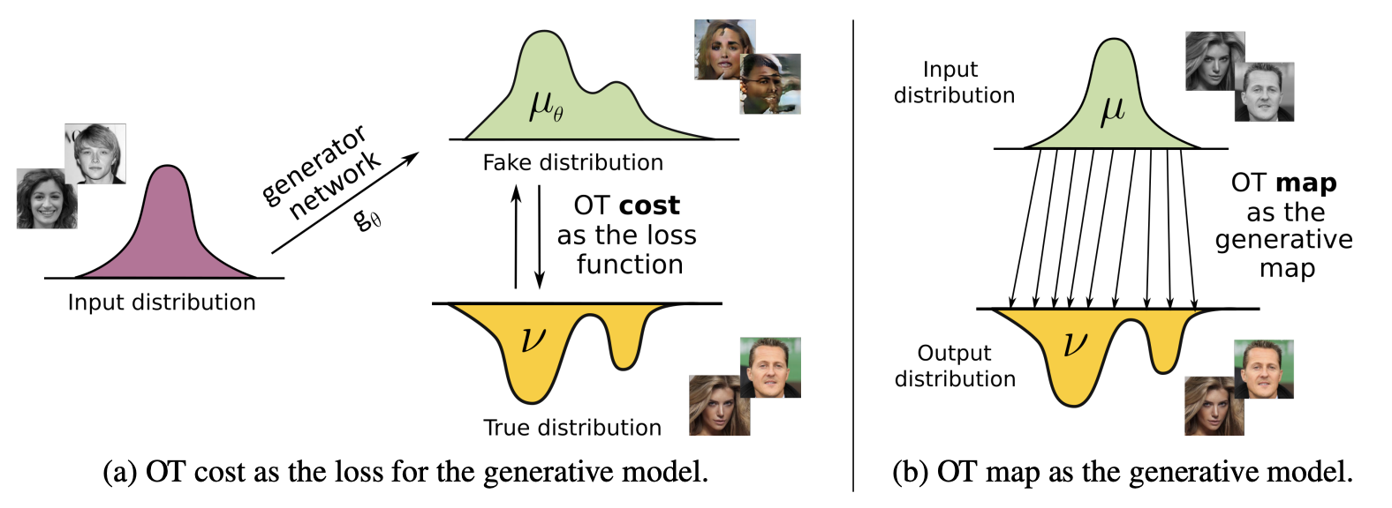
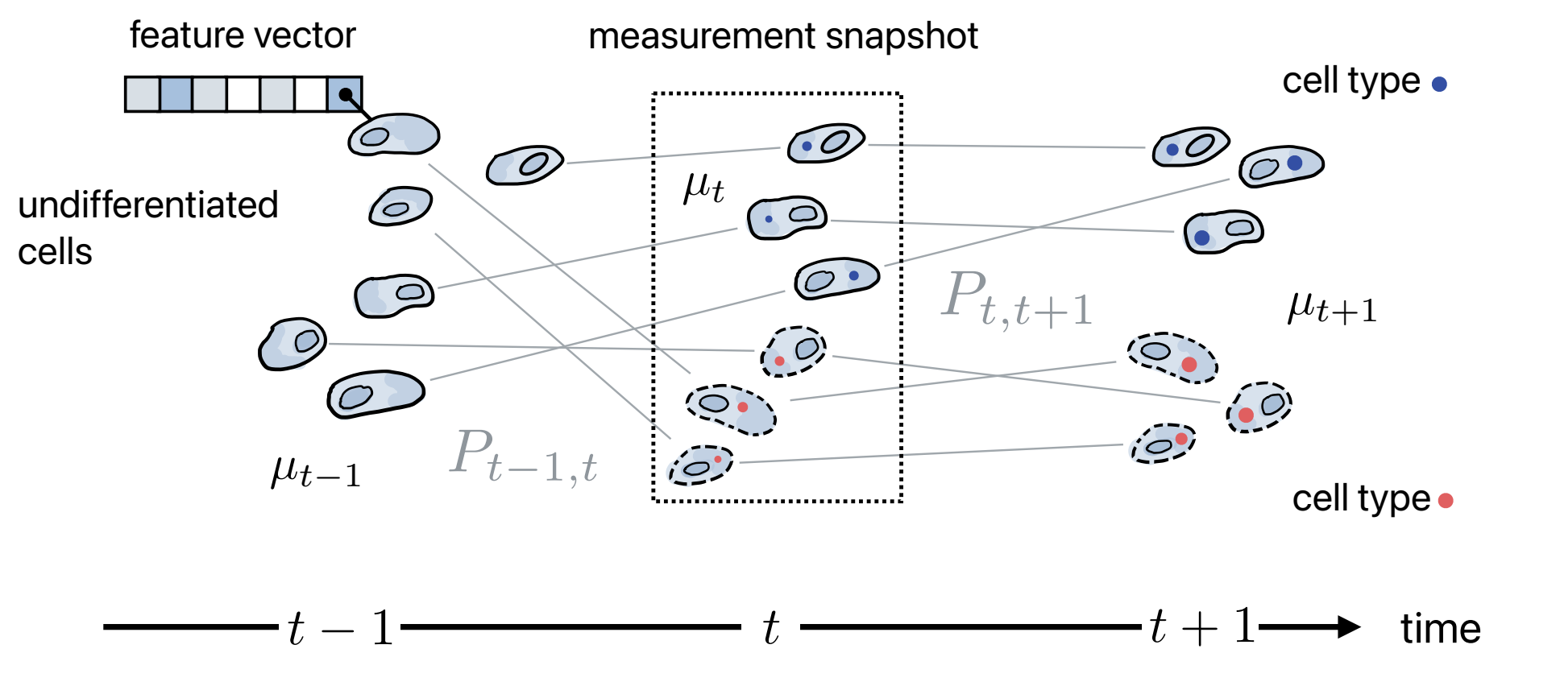
Why optimal transport?
(selected ML-focused highlights)
Defines a metric on the space of measures
(metricizes the space of weak convergence)
📚 Wasserstein GAN. Arjovsky, Chintala, Bottou, ICML 2017.
📚 Generalized sliced Wasserstein distances. Kolouri et al., NeurIPS 2019.
📚 Sliced wasserstein distance for learning GMMs. Kolouri et al., CVPR 2018.
📚 Convolutional Wasserstein Distances on Geometric Domains. Solomon et al., ToG 2015.
Couples measures without pairwise data
(e.g., for generative modeling, domain adaptation)
📚 Generative modeling via OT maps. Rout, Korotin, Burnaev. ICLR 2022.
📚 Neural Optimal Transport. Korotin et al., ICLR 2023
📚 Neural Monge map estimation. Jiaojiao Fan et al., TMLR 2023.
📚 Joint distribution optimal transportation for domain adaptation. Courty et al., NeurIPS 2017.
📚 Geometric Dataset Distances via Optimal Transport. Alvarez-Melis et al., NeurIPS 2020.
source: Generative Modeling with Optimal Transport Maps by Rout et al.
Finds interpolating paths between populations
(e.g., for cell populations or multi-agent systems)
📚 Optimal-transport analysis of single-cell gene expression. Schiebinger et al., Cell 2019.
📚 Learning single-cell perturbation responses using neural optimal transport. Bunne et al., Nature Methods 2023.
📚 Likelihood Training of Schrödinger Bridge. Liu, Horng, Theodorou. ICLR 2022.
📚 Trajectorynet: A dynamic optimal transport network for modeling cellular dynamics. Tong et al., ICML 2020.
source: Bunne and Cuturi

Slide 13
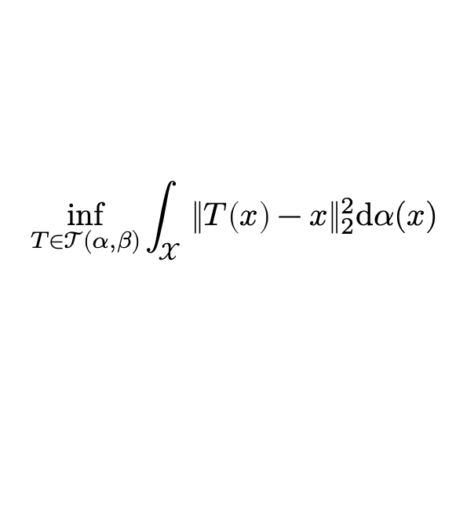
Flows = “suboptimal” transport
(many extensions/applications)
(data)
(base)
Flows “just” care about matching samples from the data
Transport path usually chosen to be easy and decomposable
Optimal transport requires searching over the entire transport space
Challenging optimization problem, no nice decompositions
Monge’s problem (squared Euclidean)
$$\inf_{T∈𝒯(α, β)}{\int_{𝒳}{{\left\|T\left(x\right)−x\right\|}_{2}^{2}\text{d}α(x)}}$$
find a map connecting $α$ and $β$ that minimally displaces mass

Slide 14
Flows = “suboptimal” transport
(many extensions/applications)
(data)
(base)
Flows “just” care about matching samples from the data
Transport path usually chosen to be easy and decomposable
Optimal transport requires searching over the entire transport space
Challenging optimization problem, no nice decompositions
all of this: single distribution to single distribution
Monge’s problem (squared Euclidean)
$$\inf_{T∈𝒯(α, β)}{\int_{𝒳}{{\left\|T\left(x\right)−x\right\|}_{2}^{2}\text{d}α(x)}}$$
find a map connecting $α$ and $β$ that minimally displaces mass

Slide 15
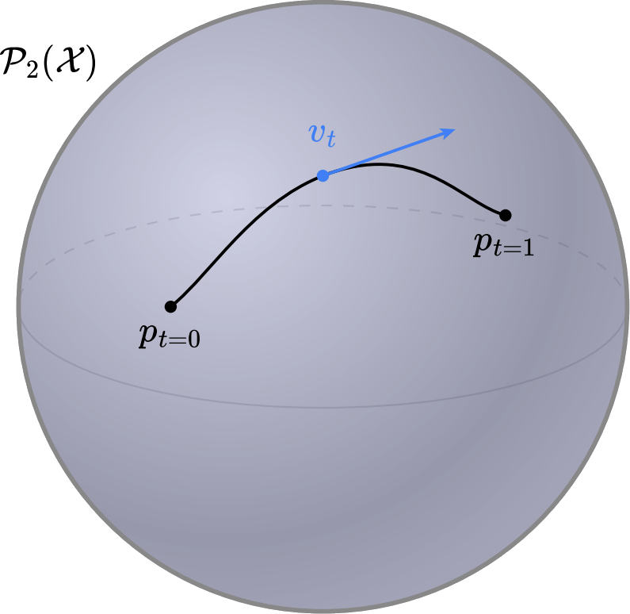

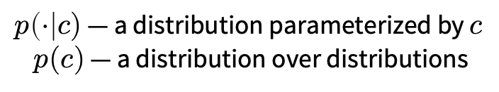
To distributions over distributions
single flow
multiple flows
(Wasserstein manifold)
$p_{t=0}$ and $p_{t=1}$ — distributions
$p\left(⋅\right|c)$ — a distribution parameterized by $c$
$p(c)$ — a distribution over distributions

Slide 16
Why distributions over distributions?
Text to image, video, or other media
between many text prompts

Slide 17
Why distributions over distributions?
Text to image, video, or other media
between many text prompts
Image editing
between many pairs of images
📚 Meta Optimal Transport. Amos et al., ICML 2023.

Slide 18
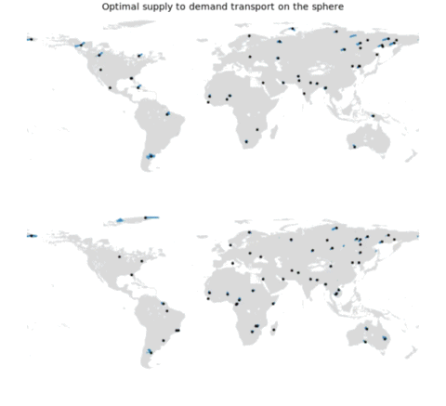
Why distributions over distributions?
Text to image, video, or other media
between many text prompts
Image editing
between many pairs of images
Scheduling and supply-demand allocations
between many initial conditions
📚 Meta Optimal Transport. Amos et al., ICML 2023.

Slide 19
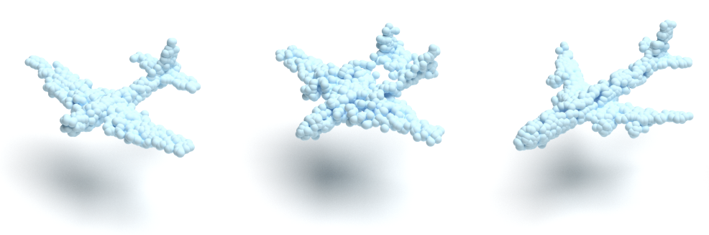
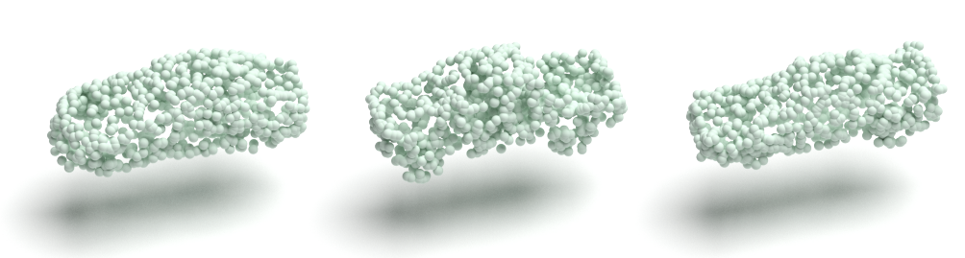
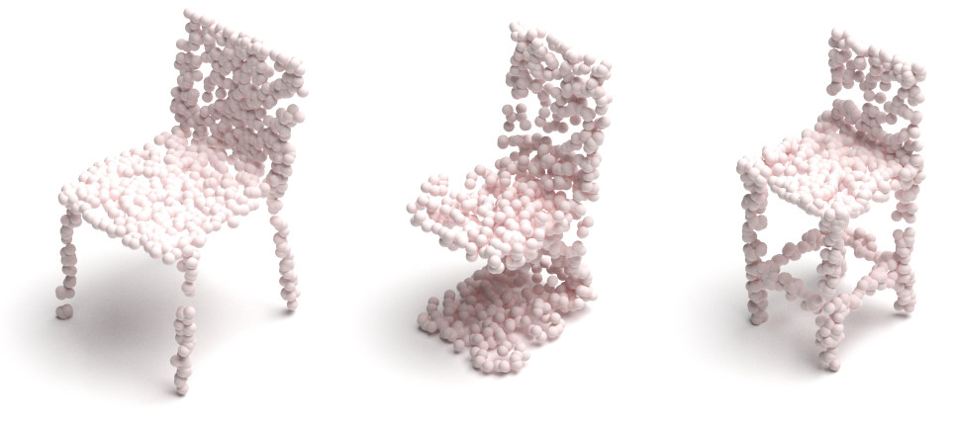
Why distributions over distributions?
Text to image, video, or other media
between many text prompts
Image editing
between many pairs of images
Scheduling and supply-demand allocations
between many initial conditions
Point cloud generation
each point cloud is an empirical distribution
📚 Wasserstein Flow Matching. Haviv*, Pooladian*, Pe’er, Amos. 2024.

Slide 20
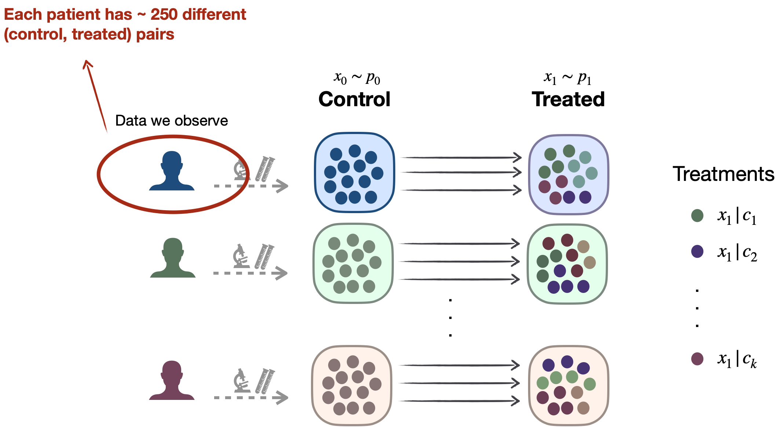
Why distributions over distributions?
Text to image, video, or other media
between many text prompts
Image editing
between many pairs of images
Scheduling and supply-demand allocations
between many initial conditions
Point cloud generation
each point cloud is an empirical distribution
Cellular transport
many pairs of untreated to treated populations
📚 Meta Flow Matching. Atanackovic et al., 2024.

Slide 21
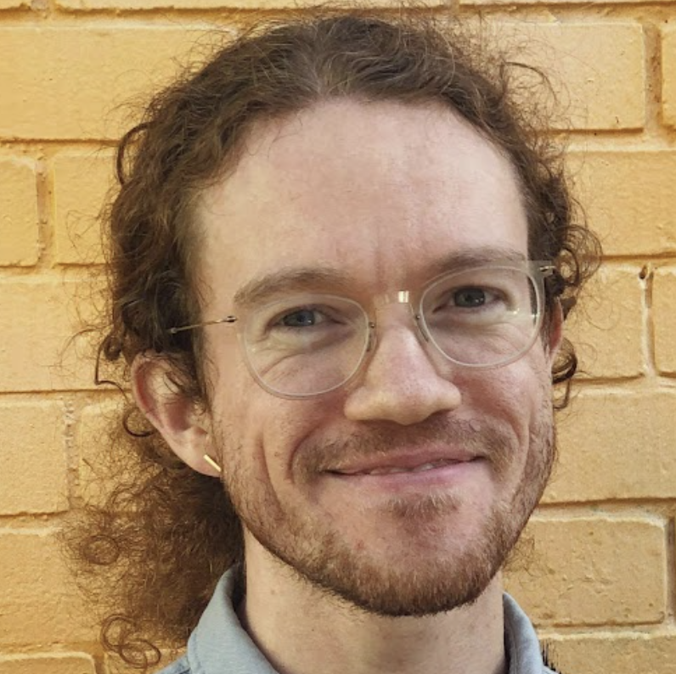
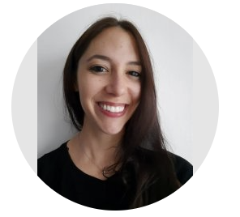
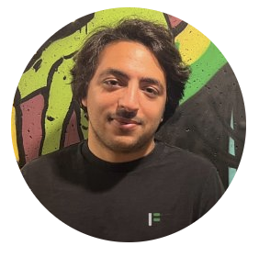
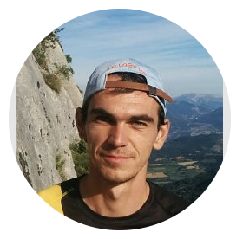
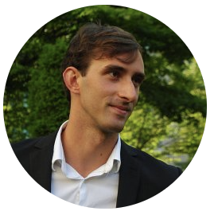
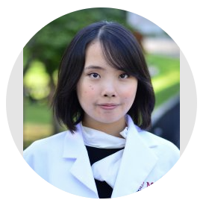
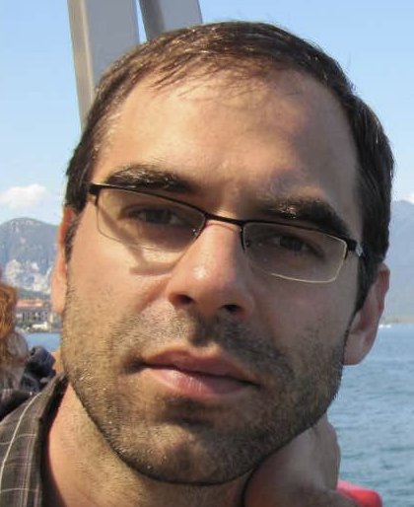
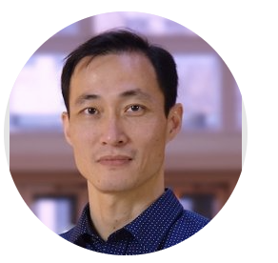
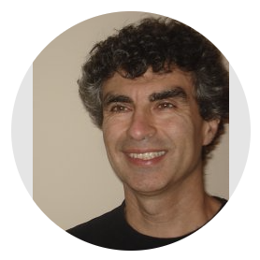
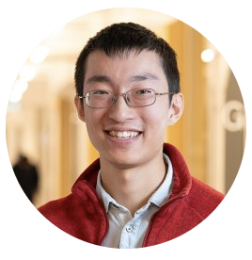

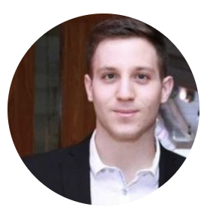
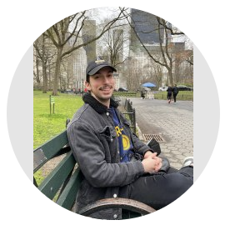
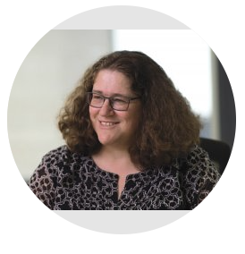
Talk overview
📚 Primer on amortized optimization [Foundations and Trends in ML, 2023]
📚 Meta Optimal Transport [ICML 2023]
📚 Meta Flow Matching [2024]
📚 Wasserstein Flow Matching [2024]

Slide 22
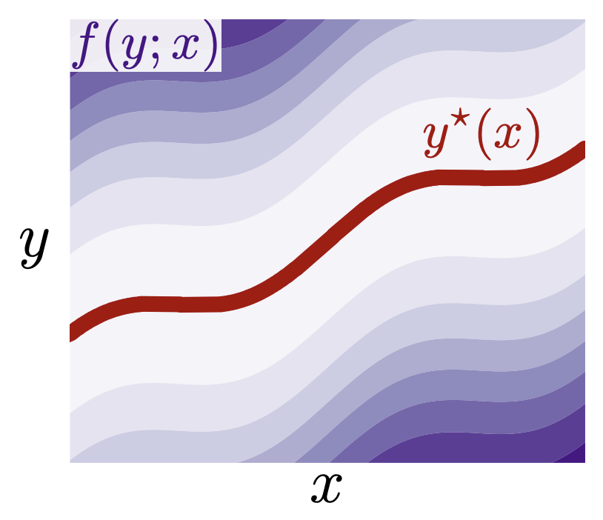
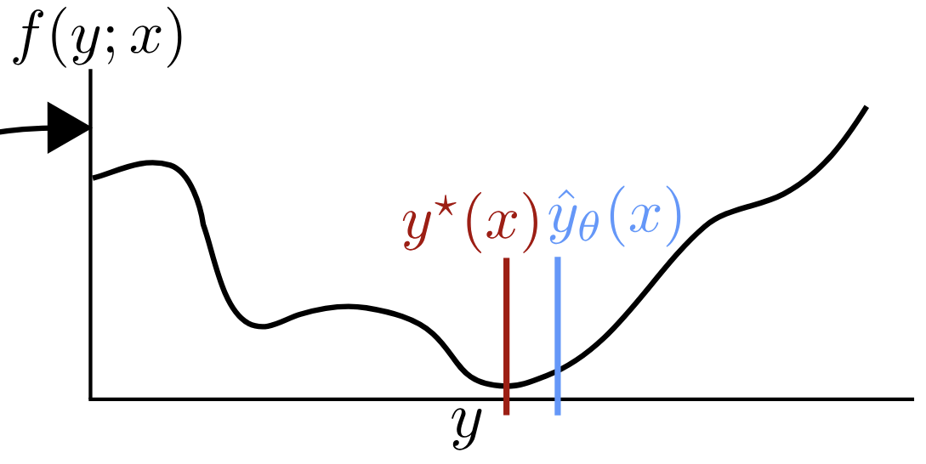

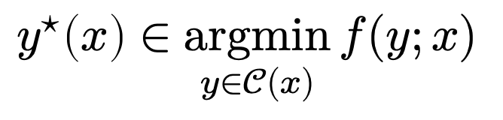
A crash course on amortized optimization
*also referred to as learned optimization
📚 Tutorial on amortized optimization. Amos, Foundations and Trends in Machine Learning 2023.
optimal solution
cost
context (state of the world)
$$y^{⋆}\left(x\right)∈\underset{y∈𝒞(x)}{argmin}{f(y;x)}$$
domain
slow thinking: solve from scratch (e.g., with search, planning)
(amortization)
fast thinking: rapidly predict the solution
why? can be 25,000+ times faster (in VAEs)

Slide 23
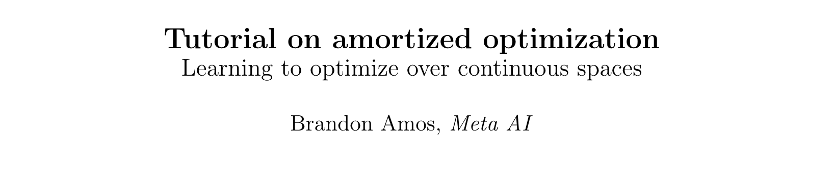
Existing, widely-deployed uses of amortization
📚 Tutorial on amortized optimization. Amos, Foundations and Trends in Machine Learning 2023.
Reinforcement learning and control (actor-critic methods, SAC, DDPG, GPS, BC)
Variational inference (VAEs, semi-amortized VAEs)
Meta-learning (HyperNets, MAML)
Sparse coding (PSD, LISTA)
Roots, fixed points, and convex optimization (NeuralDEQs, RLQP, NeuralSCS)
Foundations and Trends® in Machine Learning

Slide 24
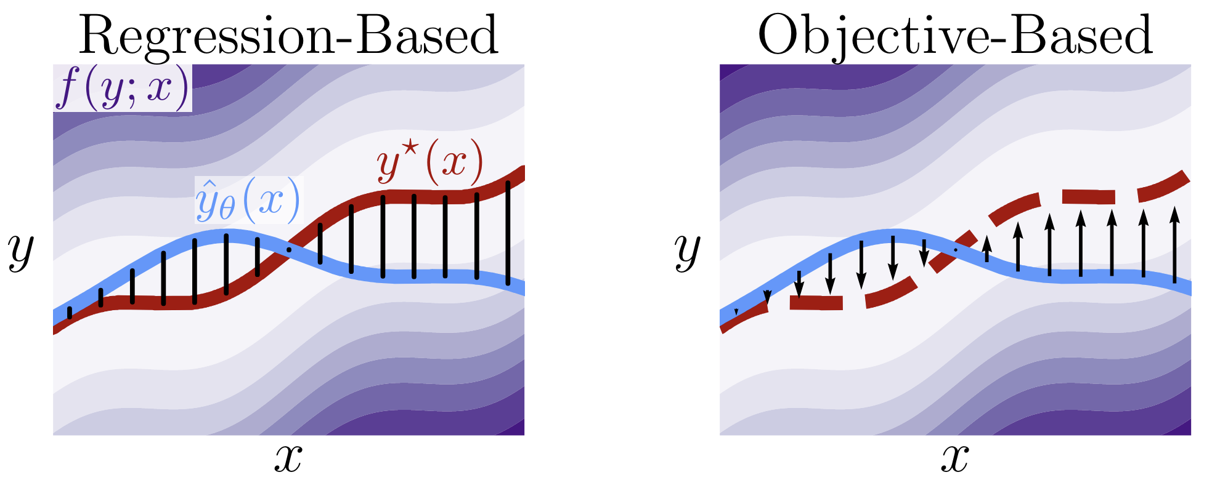
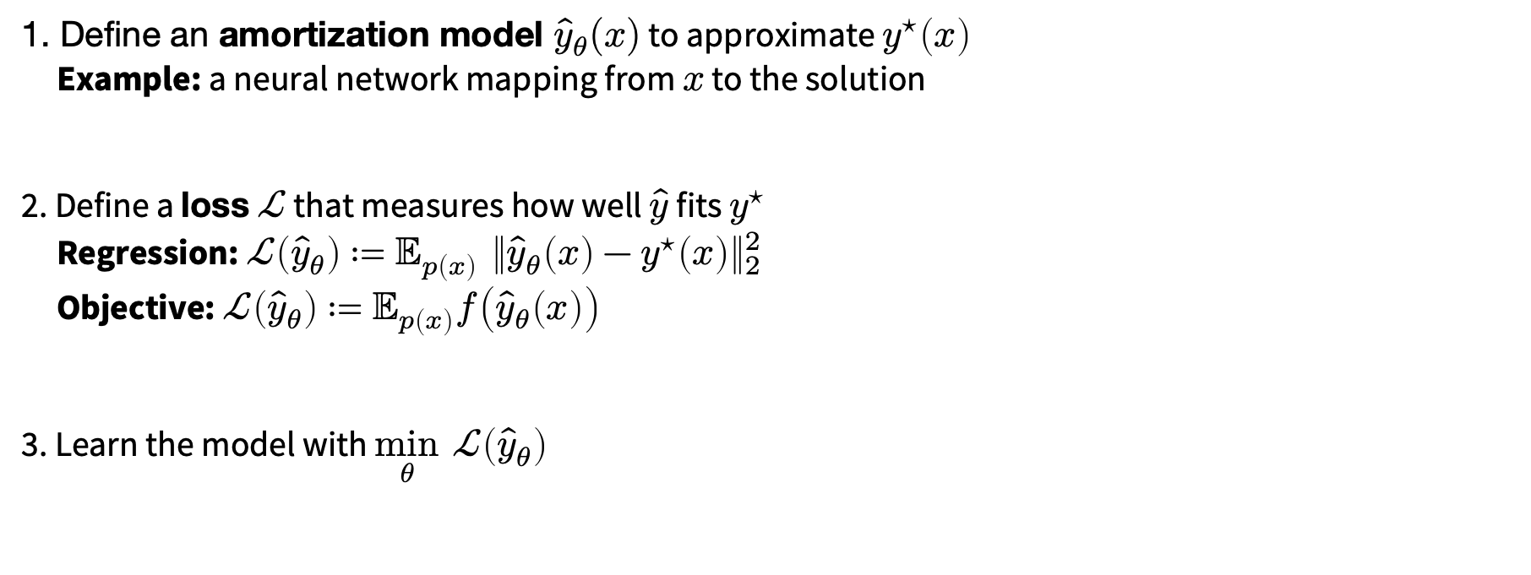
How to amortize?
📚 Tutorial on amortized optimization. Amos, Foundations and Trends in Machine Learning 2023.
1. Define an amortization model ${\hat{y}}_{θ}(x)$ to approximate $y^{⋆}\left(x\right)$
Example: a neural network mapping from $x$ to the solution
2. Define a loss $ℒ$ that measures how well $\hat{y}$ fits $y^{⋆}$
Regression: $ℒ\left({\hat{y}}_{θ}\right)≔𝔼_{p\left(x\right)} {\left\|{\hat{y}}_{θ}\left(x\right)−y^{⋆}\left(x\right)\right\|}_{2}^{2}$
Objective: $ℒ\left({\hat{y}}_{θ}\right)≔𝔼_{p\left(x\right)}f\left({\hat{y}}_{θ}\left(x\right)\right)$
3. Learn the model with $\min_{θ} ℒ\left({\hat{y}}_{θ}\right)$

Slide 25
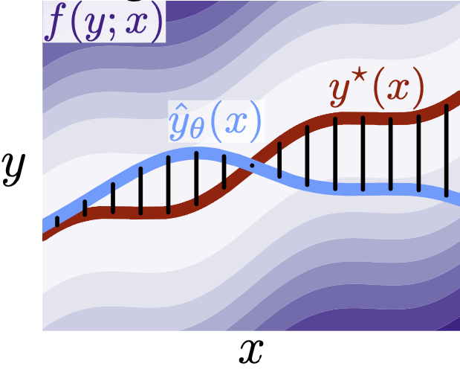
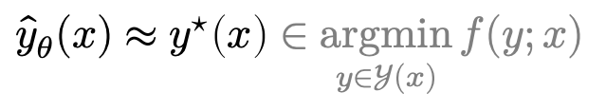
Why call it amortized optimization?
📚 Tutorial on amortized optimization. Amos. FnT in ML, 2023.
to amortize: to spread out an upfront cost over time
$${\hat{y}}_{θ}(x)≈y^{⋆}\left(x\right)∈\underset{y∈𝒴(x)}{argmin}{f(y;x)}$$
expensive upfront cost
training the model
fast approximate solutions

Slide 26
Talk overview
📚 Primer on amortized optimization [Foundations and Trends in ML, 2023]
📚 Meta Optimal Transport [ICML 2023]
📚 Meta Flow Matching [2024]
📚 Wasserstein Flow Matching [2024]

Slide 27
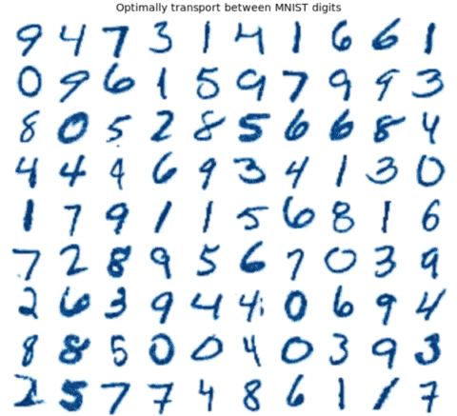
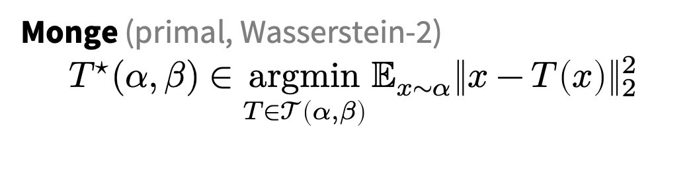
Challenge: computing OT maps
📚 Meta Optimal Transport. Amos et al., ICML 2023.
Monge (primal, Wasserstein-2)
$${T^{⋆}(α, β)∈\underset{T∈𝒯\left(α, β\right)}{argmin}{𝔼_{x∼α}\left\|x−T\left(x\right)\right\|}}_{2}^{2}$$
we also consider other/discrete OT formulations
Many OT problems are numerically solved
Improving OT solvers is active research
Solving multiple OT problems: even harder
Standard solution: independently solve

Slide 28
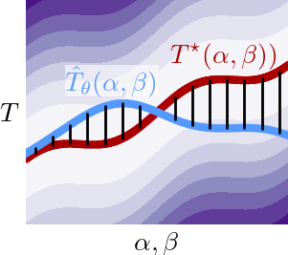
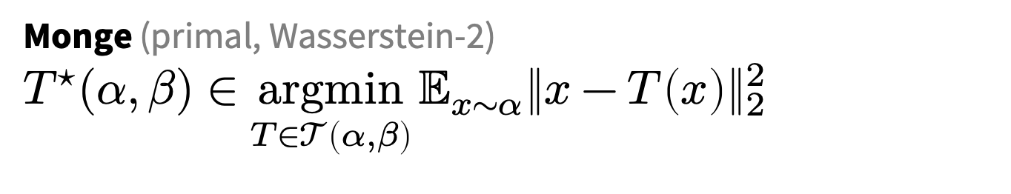

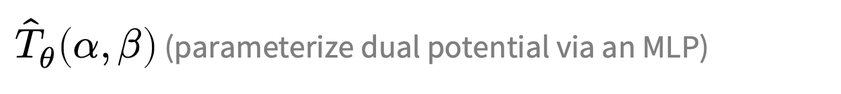
Meta Optimal Transport
Idea: predict the solution to OT problems with amortized optimization
Simultaneously solve many OT problems, sharing info between instances
Why call it “meta”? Instead of solving a single OT problem, learn how to solve many
(via amortization)
Monge (primal, Wasserstein-2)
$${T^{⋆}(α, β)∈\underset{T∈𝒯\left(α, β\right)}{argmin}{𝔼_{x∼α}\left\|x−T\left(x\right)\right\|}}_{2}^{2}$$
$$≈$$
${\hat{T}}_{θ}\left(α, β\right)$ (parameterize dual potential via an MLP)
we also consider other/discrete OT formulations

Slide 29
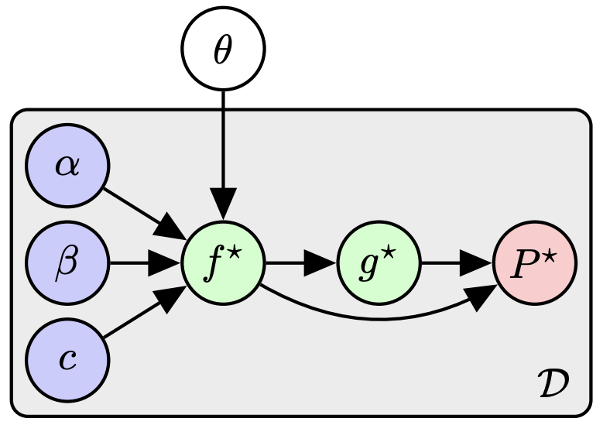
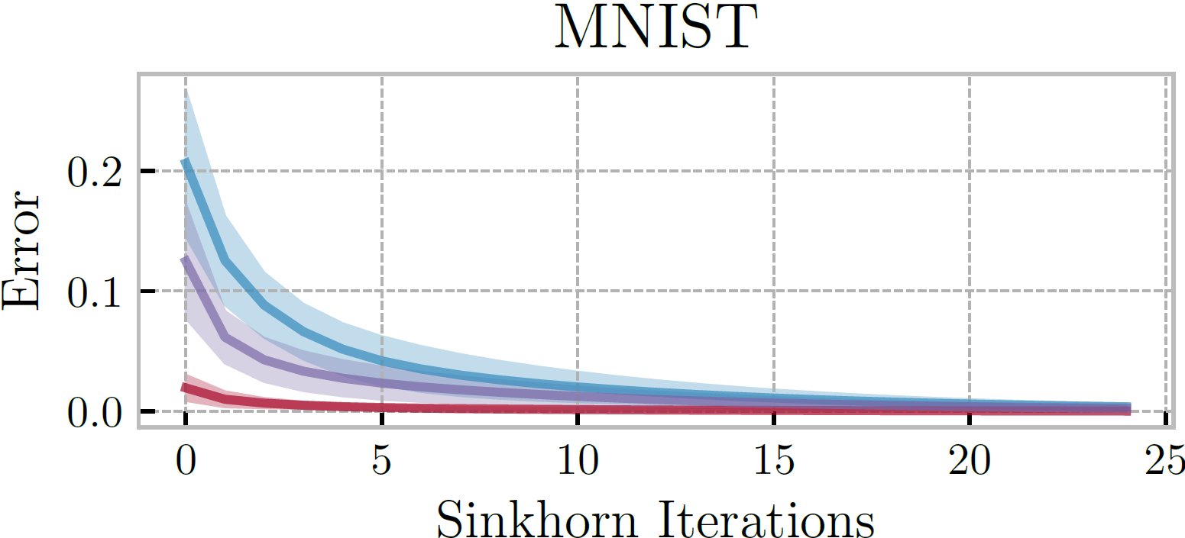
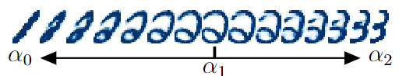


Meta OT for Discrete OT (Sinkhorn)
📚 Sinkhorn Distances: Lightspeed Computation of Optimal Transport. Marco Cuturi, NeurIPS 2013.

Slide 30


Wasserstein adversarial regularization
📚 Wasserstein adversarial regularization for learning with label noise. Kilian Fatras et al., TPAMI 2021.
Setting: discrete OT for classification with label noise
OT is repeatedly solved across minibatches
Use Meta OT to learn better solutions

Slide 31


Meta OT in continuous settings (W2GN)
📚 Wasserstein-2 Generative Networks. Alexander Korotin et al., ICLR 2021.
RGB color palette transport

Slide 32
More Meta OT color transfer predictions
📚 Meta Optimal Transport. Amos et al., ICML 2023.

Slide 33



Conditional Monge Maps
📚 Supervised Training of Conditional Monge Maps. Bunne, Krause, Cuturi, NeurIPS 2022.
Focus: predicting drug treatments with OT
Idea: condition OT map on patient information
Methodological differences
Conditional Monge Maps $≈$ Neural Processes
Predict conditioning inputs of the OT map
Meta OT $≈$ Hyper-Networks
Predict parameters of an OT map
image sources: Bunne and Cuturi

Slide 34
Talk overview
📚 Primer on amortized optimization [Foundations and Trends in ML, 2023]
📚 Meta Optimal Transport [ICML 2023]
📚 Meta Flow Matching [2024]
📚 Wasserstein Flow Matching [2024]

Slide 35











Background and Motivation
In many scientific problems, we want to understand the dynamics of many-body problems
(the dynamic evolution of interacting particles)
E.g. the dynamic processes cells undergo w.r.t. their environment and interactions with each other
$$p_{t}$$
$$p_{0}$$
$$p_{1}$$

Slide 36




Background and Motivation
We want to model the dynamics of particles (or cells) at the population level. Many methods do this:
Tong et al, ICML, 2020
Bunne et al, Nature Methods, 2023
Neklydov et al, ICML, 2024
Schiebinger et al, Cell, 2019
Existing methods typically only model the evolution of cells as independent particles.

Slide 37


Background and Motivation
We would also like a model that can generalize across measures (populations)
Data we observe
$$x_{0}∼p_{0}$$
$$x_{1}∼p_{1}$$
.
.
.
“unseen” population
Existing methods are typically restricted to a single measure (population, patient). At best can condition on different dynamics.

Slide 38



Problem setup
We want a model that can:
1. model the evolution of particles while taking into account their interactions
2. generalize across unseen populations
$$x_{0}∼p_{0}$$
$$x_{1}∼p_{1}$$
Main assumptions:
1. Coupled distribution/population pairs $\{(p_{0}(x_{0}|i),p_{1}(x_{1}|i))\}_{i=1}^{N}$
2. The collected data undergoes a universal developmental process
depends only on the population itself (e.g., interacting particles or communicating cells)
$$p_{0}$$
$$p_{1}$$

Slide 39









From Flow Matching to Meta Flow Matching
$$\frac{∂p_{t}(x)}{∂t}=−⟨∇_{x},p_{t}(x)v_{t}^{∗}(x)⟩$$
$$p_{t}$$
(Wasserstein manifold)
$p_{t=0}$ and $p_{t=1}$ — distributions
$p\left(⋅\right|c)$ — a distribution parameterized by $c$
$p(c)$ — a distribution over distributions

Slide 40



From Flow Matching to Meta Flow Matching
$$\frac{∂p_{t}(x)}{∂t}=−⟨∇_{x},p_{t}(x)v_{t}^{∗}(x)⟩$$
$$\frac{∂p_{t}(x)}{∂t}=−⟨∇_{x},p_{t}(x)v_{t}^{∗}(x,p_{t})⟩$$
(from assumptions: end up just conditioning on $p_{0}$)
(Wasserstein manifold)
$p_{t=0}$ and $p_{t=1}$ — distributions
$p\left(⋅\right|c)$ — a distribution parameterized by $c$
$p(c)$ — a distribution over distributions

Slide 41











Meta Flow Matching
A model to learn to represent the population (GCN w/ knn edge pooling)
$$(x(t_{0}),t_{0})$$
$$h$$
$$(x(t_{0}),t_{0})$$
$$φ(p_{0},θ)$$
$v$ approximates the population dynamics given
1. representation of the population, and
2. additional seen conditions $c$ (e.g. treatments applied to population)
$$φ(p_{0},θ)$$
$$c$$
$$v_{t}(x,h,c;ω)$$
.
.
.
$$h=φ(p_{0},θ)$$
$$φ(p_{0},θ)$$
$φ(p_{0},θ)$ (GCN) captures interactions between particles

Slide 42


Slide 43





Synthetic Example
We create a synthetic dataset of paired joint distributions $\{(p_{0}(x_{0}|i),p_{1}(x_{1}|i))\}_{i=1}^{N}$
  We define a set of pre-defined target distributions $p_{1}(x_{1}|i)$ for $i=1,…,N$ (letter silhouettes)
  To get paired $p_{0}(x_{0}|i)$ we simulate the forward diffusion process without drift $x_{0}∼𝒩(x_{1},σ)$
  We reverse the diffusion process and learn the push-forward map from $p_{0}(x_{0}|i)$ (source) to $p_{1}(x_{1}|i)$ (target) for every index $i$
Train: 24 letters (excluding ‘Y’ and ‘X’), each in 10 orientations
Test: ’Y’ and ‘X’, each in 10 orientations
source
target
source
target

Slide 44



Synthetic Example (FM baseline)
No population information
Predicts aggregate response over populations
Train
$$(x(t_{0}),t_{0})$$
$$v_{t}(x;ω)$$
Test
FM cannot fit the training data and cannot generalize to unseen populations

Slide 45





Synthetic Example (CGFM baseline)
“Perfect” conditions (naive)
A model $v$ to approximate the dynamical response given the population index/condition $c$
$$(x(t_{0}),t_{0})$$
Train
$$v_{t}(x,c;ω)$$
Test
$$c$$
Perfect information on which environment the model is working with
CGFM cannot generalize to the conditions of unseen populations

Slide 46





Synthetic Example (MFM)
Learned Conditions
A model $v$ to approximate the dynamical response given a learned representation of the population
$$(x(t_{0}),t_{0})$$
Train
$$v_{t}(x,h;ω)$$
$$h=φ(p_{0},θ)$$
Test
MFM learns to represent entire populations, hence generalizes across unseen populations

Slide 47


Synthetic Example

Slide 48






Biological data — patient-specific organoid drug screen dataset
Each patient has ~ 250 different (control, treated) pairs
Mass Cytometry
$$x_{0}∼p_{0}$$
$$x_{1}∼p_{1}$$
Control
Treated
Data we observe
Treatments
$$x_{1}|c_{1}$$
$$x_{1}|c_{2}$$
.
.
.
.
.
.
$$x_{1}|c_{k}$$
(Zapatero et al, Cell, 2023)
10 patients, 11 treatments, varying doses, 3 different cell cultures … up to 2500 different environmental conditions! (we use ~ 1000)

Slide 49

Organoid Drug Screen Data

Slide 50

“Replica” Split

Slide 51

Patient Split

Slide 52
Talk overview
📚 Primer on amortized optimization [Foundations and Trends in ML, 2023]
📚 Meta Optimal Transport [ICML 2023]
📚 Meta Flow Matching [2024]
📚 Wasserstein Flow Matching [2024]

Slide 53
So far: distributions over pairs of distributions
Meta OT and Meta FM assume (coupled) pairs of distributions
source
target
Control
Treated

Slide 54


What if we have unpaired distributions?
📚 Wasserstein Flow Matching. Haviv, Pooladian, Pe’er, Amos. 2024.
Still can learn a flow between them

Slide 55

Why would we have unpaired distributions?
Want to do generative modeling where the data points are inherently distributions
point clouds
biological data

Slide 56

Related: flows for categorical distributions
📚 Dirichlet Flow Matching. Stark et al., NeurIPS 2024.
📚 Fisher Flow Matching. Davis et al., ICML 2024.

Slide 57


How to flow on the Wasserstein manifold?
📚 Riemannian Flow Matching. Chen and Lipman, ICLR 2024.
Use Riemannian flow matching with the geodesics (OT paths) on the Wasserstein manifold

Slide 58

Point cloud generation results
Competitive and don’t require spatially discretizing the domain like most of the baselines

Slide 59

WFM also does interpolations and completions
Flow from a distribution over lamps to a distribution over handbags
Completion using a flow trained over a distribution of planes

Slide 60
Transport and flows between distributions over distributions
Brandon Amos • Meta, NYC
slides
bamos.github.io/presentations

